Slide 1
Entity Framework
Date

Slide 2
Entity Framework – What?
Entity Framework (EF) is an object-relational mapper that enables .NET developers to work with relational data using domain-specific objects
Entity Framework – When?
When use of ORM weighs over using a traditional DB
When the database growth is predictable and organic

Slide 3
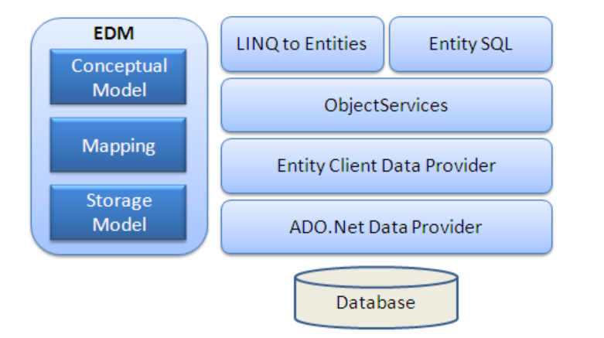
EF Architecture

Slide 4
Creating Entity Data Model
Entity Framework uses EDM for all the database-related operations. Entity Data Model is a model that describes entities and the relationships between them
Model Browser
The Model Browser gives you information about all the objects and functions EDM has created. To open the Model Browser, right click the empty surface of the EDM designer and select Model Browser from the context menu. Model Browser will appear in the area where you normally find Solution Explorer and Properties.

Slide 5
DbContext
DbContext instance represents a combination of the Unit Of Work and Repository patterns such that it can be used to query from a database and group together changes that will then be written back to the store as a unit
Eager and Lazy Loading
Eager loading is the process whereby a query for one type of entity also loads related entities as part of the query, so that we don't need to execute a separate query for related entities. Eager loading is achieved using the Include() method
Lazy loading is delaying the loading of related data, until you specifically request for it. It is the opposite of eager loading

Slide 6
Types of Entity
POCO Entities (Plain Old CLR Object)
A POCO entity is a class that doesn't depend on any framework-specific base class. It is like any other normal .NET CLR class, which is why it is called "Plain Old CLR Objects".
Dynamic Proxy Entities (POCO Proxy)
Dynamic Proxy is a runtime proxy class which wraps POCO entity. Dynamic proxy entities allow lazy loading.

Slide 7
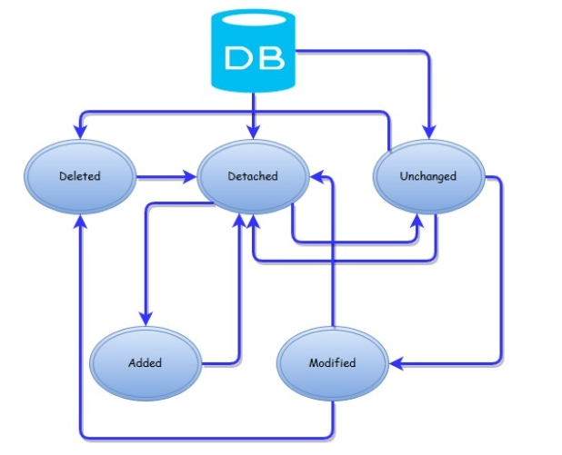
Entity Lifecycle

Slide 8
Model Binding
Object Relational Mapping (ORM)
Entity Framework is an Object Relational Mapper (ORM) which is a type of tool that simplifies mapping between objects in your software to the tables and columns of a relational database. Entity Framework (EF) is an open source ORM framework for ADO.NET which is a part of .NET Framework

Slide 9
Entity Framework Developer
Workflows
Database First (Existing Database)
Reverse engineer model in designer
Classes auto generated from model
Code First (New Database)
Define classes and mapping in code
Database created from Model
Use Migrations to evolve the model

Slide 10
Entity Framework Developer
Model First( New Database)
Create model in designer
Database created from Model
Classes auto generated from model
System.Data.Entity Namespace
Contains classes that provide access to the core functionality of the Entity framework
Enable you to query, insert, update and delete data using CLR strongly typed objects

Slide 11
DbSet<TEntity>
A DbSet represents the collection of all entities in the context, or that can be queried from the database, of a given type.

Slide 12
Creating Unit Testable Applications in ASP.NET MVC
The primary goal of unit testing is to take the smallest piece of testable software in the application and determine whether it behaves exactly as you expect. Each unit is tested separately before integrating them into modules to test the interfaces between modules

